Slide 1
Contextualized Semantic Memory using Spreading Activation
SemMemDB
Jay Ricco
riccoj@wit.edu
Wentworth Institute of Technology

Slide 2
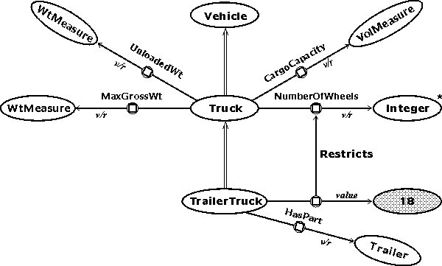
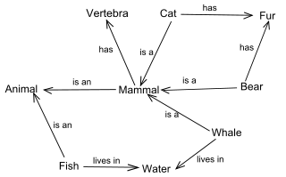
Review of Semantic Memory
Fact-based long term memory store
Songs by a certain artist
How many wheels a common car has
Memory elements stored in a digraph structure
Inserted data is placed in graph structure based on relations as execution continues
Retrieval occurs as either a direct lookup or query-based retrieval
Query-based retrieval can lead to some issues with both efficiency and accuracy (ambiguity).

Slide 3
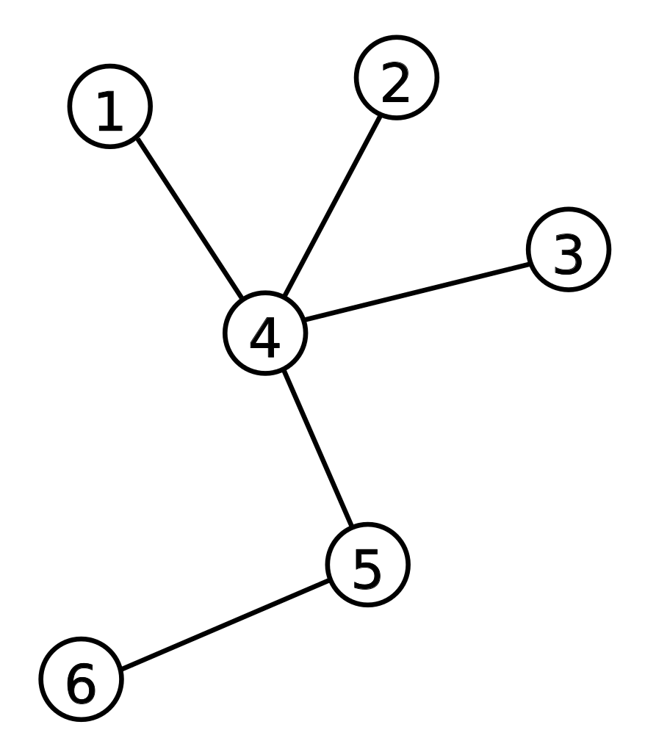
Review of Spreading Activation
Allows context to affect SMEM retrieval
Word-sense disambiguation
Conversational topics
Beneficial for query-based lookup to increase chances of correct retrieval
Elements in working memory provide the “context”
Possible nodes become weighted based on # of edges between themselves & WME’s
The greater the number of relations between the node & the WME, the larger the probability of retrieval is
In WM
4 gets boost,
4 is retrieved:
In WM
Nodes with parent of 4
more likely to be chosen
Notes:
Elements in working memory are used as the query for spreading activation

Slide 4
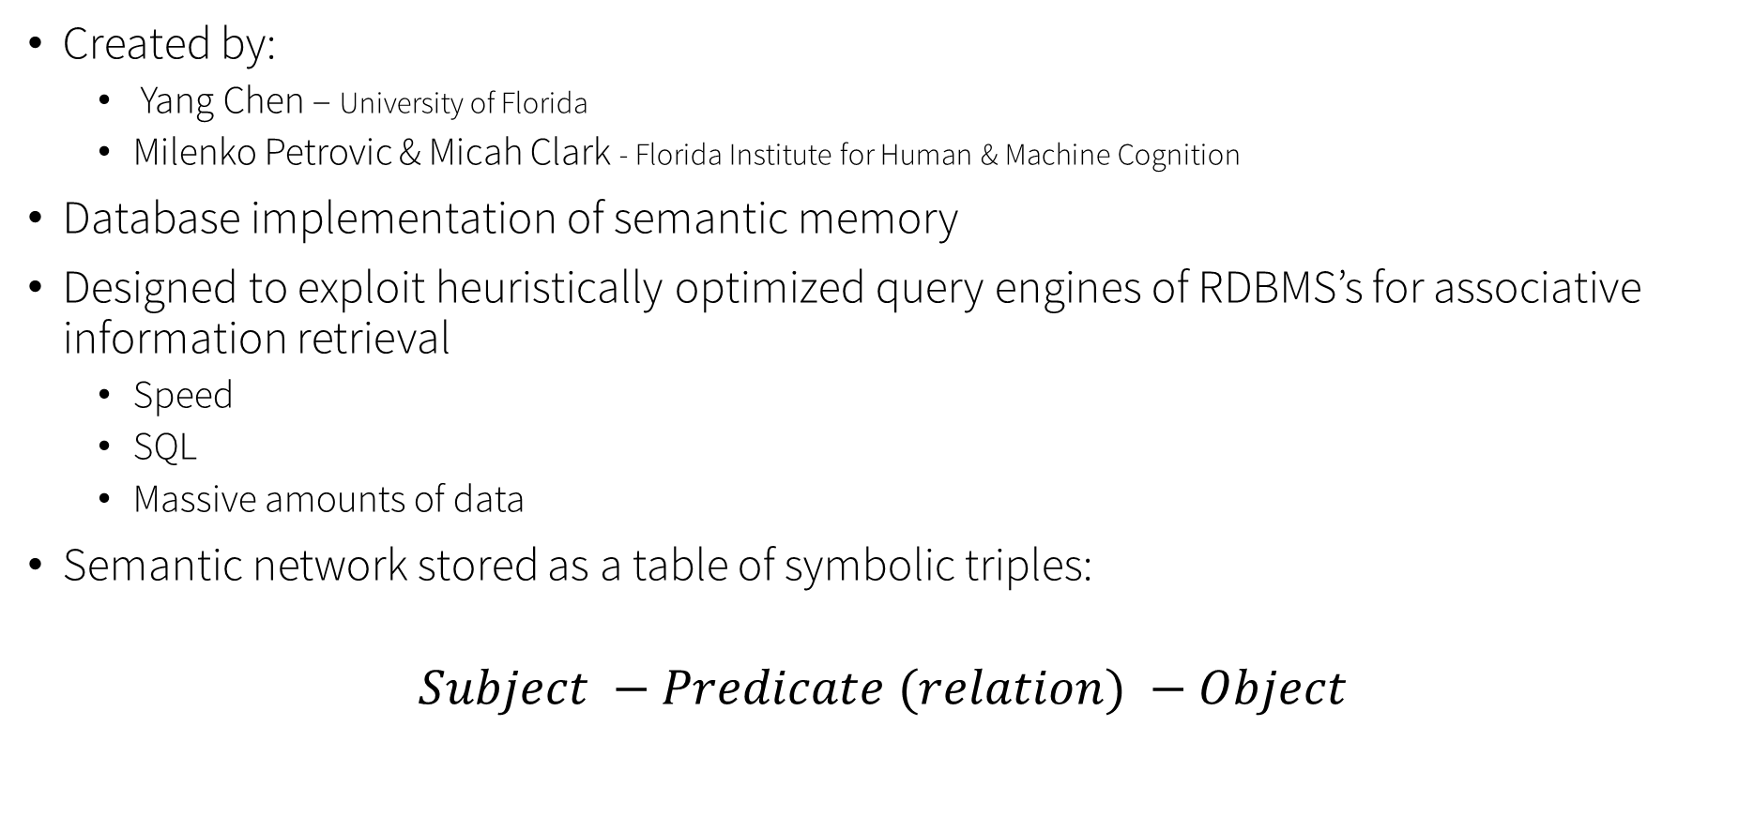
SemMemDB (FLAIRS-27 2014)
Created by:
Yang Chen – University of Florida
Milenko Petrovic & Micah Clark - Florida Institute for Human & Machine Cognition
Database implementation of semantic memory
Designed to exploit heuristically optimized query engines of RDBMS’s for associative information retrieval
Speed
SQL
Massive amounts of data
Semantic network stored as a table of symbolic triples:
$$Subject −Predicate (relation) −Object$$

Slide 5
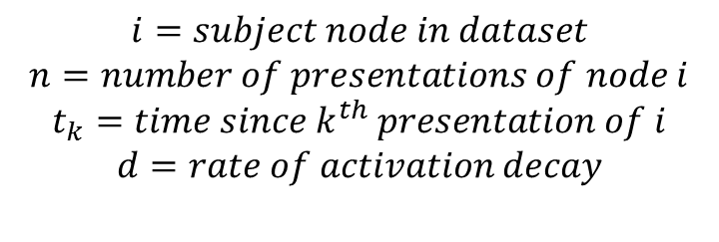
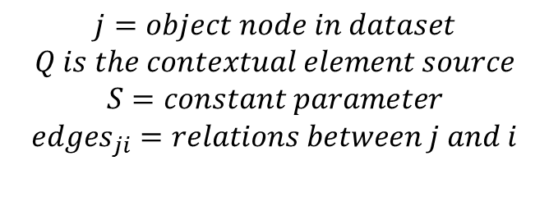
SemMemDB - Retrieval
Retrieval in SemMemDB is based on ACT-R’s base-level activation, with the addition of spreading.
Non-probabilistic graph traversal
$${RetrievalScore}_{i}= \ln\left(\sum_{k=1}^{n}{{t_{k}}^{−d}}\right)+ \sum_{j ∈ Q}{{weight}_{j}∗\left(S − \ln\left(\frac{1+{degree}_{j}}{{edges}_{ji}}\right)\right)}$$
Base-level Activation
Spreading Activation
$$i=subject node in dataset$$
$$n=number of presentations of node i$$
$$t_{k}=time since k^{th} presentation of i$$
$$d=rate of activation decay$$
$$j=object node in dataset$$
$$Q is the contextual element source$$
$$S=constant parameter$$
$${edges}_{ji}=relations between j and i$$

Slide 6
SemMemDB – Weak Points
Paper contains efficiency testing only relating dataset size and query size to time
Does not provide time data on key elements of retrieval score calculation
Connectivity of nodes
History size
Their implementation consists of a feed-forward spread
Spreading from parent node to child node
Did not implement materialized views – used tables/view hybrid instead
Did not provide data on re-indexing time for dataset inserts
If not properly indexed calculation time will increase
Does not incorporate hard constraints (only allows for look-up based on context elements)
Not integrated with cognitive architecture

Slide 7
SemMemDB – My Work
Currently have a working implementation of SemMemDB with Postgres
Toy datasets return accurate spreads from queries of “context” nodes
Our implementation contains a feed-backward spread and materialized views
Future Work:
Comprehensive testing and analysis of timing
Calculation
Re-indexing/MV refresh
Drop Postgres as RDBMS and produce a standalone C++ implementation
No need to connect to DB server/use interface drivers
Optimize algorithms to efficiently be able to retrieve resultant nodes in as little time as possible

Slide 8


Golden Nuggets and Coal
Our implementation is currently functional and does produce an accurate spread based on trials with toy datasets
We have a good path-to-goal for our research, and should achieve bigger and better in the coming weeks!
No official empirical data!

